Slide 1
Software Testing Laboratory
SOFTWARE TESTING LABORATORY
Subject Code: 22IS73
7. Design, develop, code and run the program in any suitable language to implement the binary search algorithm. Determine the basis paths and using them derive different test cases, execute these test cases and discuss the test results.

Slide 2
Software Testing Lab
Program 8 (Binary Search - Path Testing)
/* Design, develop a code and run the program in any suitable language to implement the binary search algorithm. Determine the basis paths and using them derive different test cases execute these test cases and discuss the test results */
#include<stdio.h>
int binsrc(int x[],int low,int high,int key)
{
int mid; while(low<=high)
{
mid=(low+high)/2; if(key==x[mid])
return mid; if(key<x[mid])
high=mid-1;
else
low=mid+1;
}
return -1;
}
int main()
{
int x[20],key,i,n,succ; printf("Enter the n value"); scanf("%d",&n);
if(n>0)
{
printf("enter the elements in ascending order\n"); for(i=0;i<n;i++)
scanf("%d",&x[i]);
printf("enter the key element to be searched\n"); scanf("%d",&key);
succ=binsrc(x,0,n-1,key); if(succ>=0)
printf("Element found in position = %d\n",succ+1);
else
printf("Element not found \n");
}
else
printf("Number of element should be greater than zero\n"); return 0;
}

Slide 3
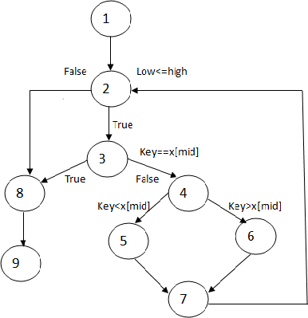
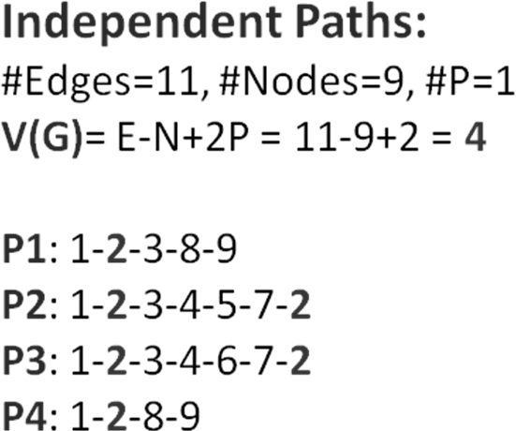
Software Testing Lab
Binary Search function with line number
int binsrc(int x[],int low,int high,int key)
{
int mid; |  |  | 1
while(low<=high) |  |  | 2
{
mid=(low+high)/2;
if(key==x[mid]) |  |  | 3
return mid; |  |  | 8
if(key<x[mid]) |  |  |  | 4
high=mid-1; |  |  | 5
else
 |  | low=mid+1; | 6
 | } |  | 7
 | return -1; |  | 8
} |  |  | 9
Program Graph – for Binary Search

Slide 4
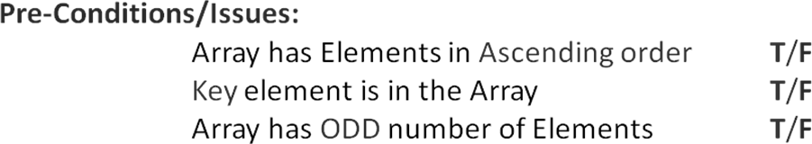
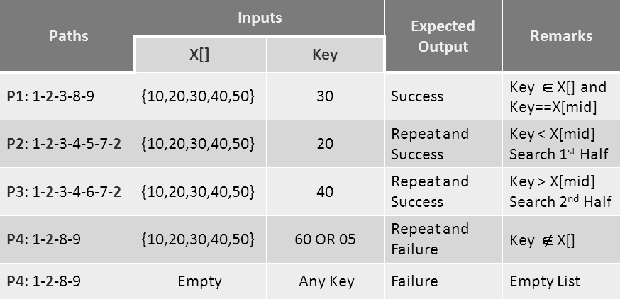
Software Testing Lab
Test Cases – Binary Search

